Slide 1
Improved Surface Normal Inference from Calibrated Illuminated RGB-D images
Jingyuan Sha

Slide 2
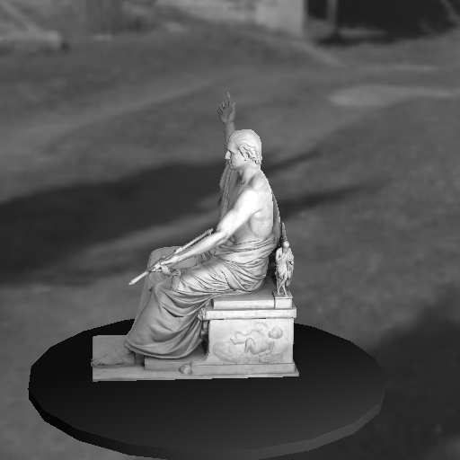
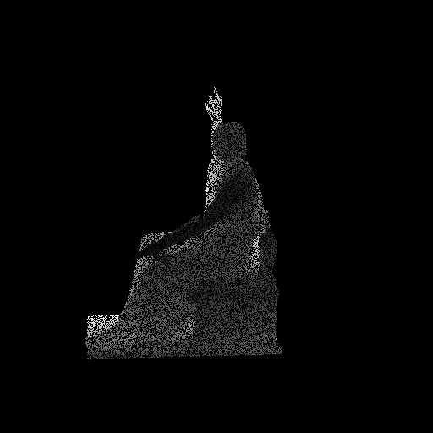
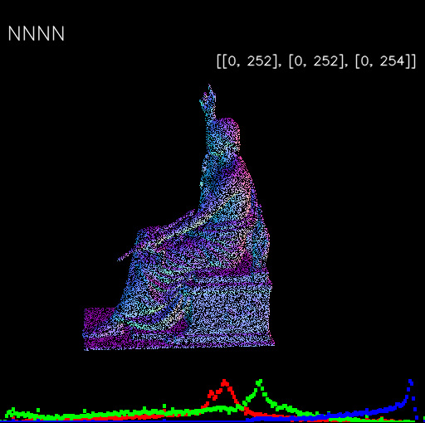

Improved Normal Inference from Calibrated illuminated RGB-d images
Standard method compute normal from point cloud using neighboring information or use Shape from shading
Grayscale image
Depth Map (semi-dense) , and known calibration
→point cloud or vertex map
Normal Map (semi-dense)
Normal Map are only semi-dense, if mapped on mesh (dense), that is not good at all
Dependent on chose neighbor size. If it is too small, → noise sensitive, If too large → too smooth and not crispy

Slide 3
Improved Normal Inference from Calibrated illuminated RGB-d images
Standard method compute normal from point cloud using neighboring information or use Shape from shading
Grayscale image
Depth Map (semi-dense) , and known calibration
→point cloud or vertex map
Normal Map (semi-dense)
Normal Map are only semi-dense, if mapped on mesh (dense), that is not good at all
Dependent on chose neighbor size. If it is too small, → noise sensitive, If too large → too smooth and not crispy

Slide 4
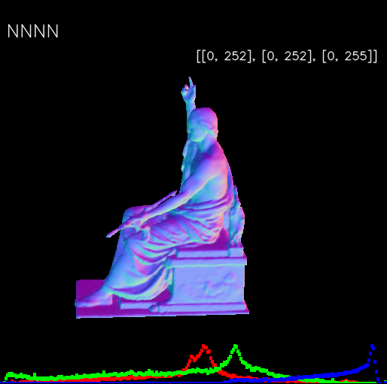
Improved Normal Inference from Calibrated illuminated RGB-d images
Grayscale image
Depth Map (semi-dense) , and known calibration
→point cloud or vertex map
Normal Map (fully dense)

Slide 5
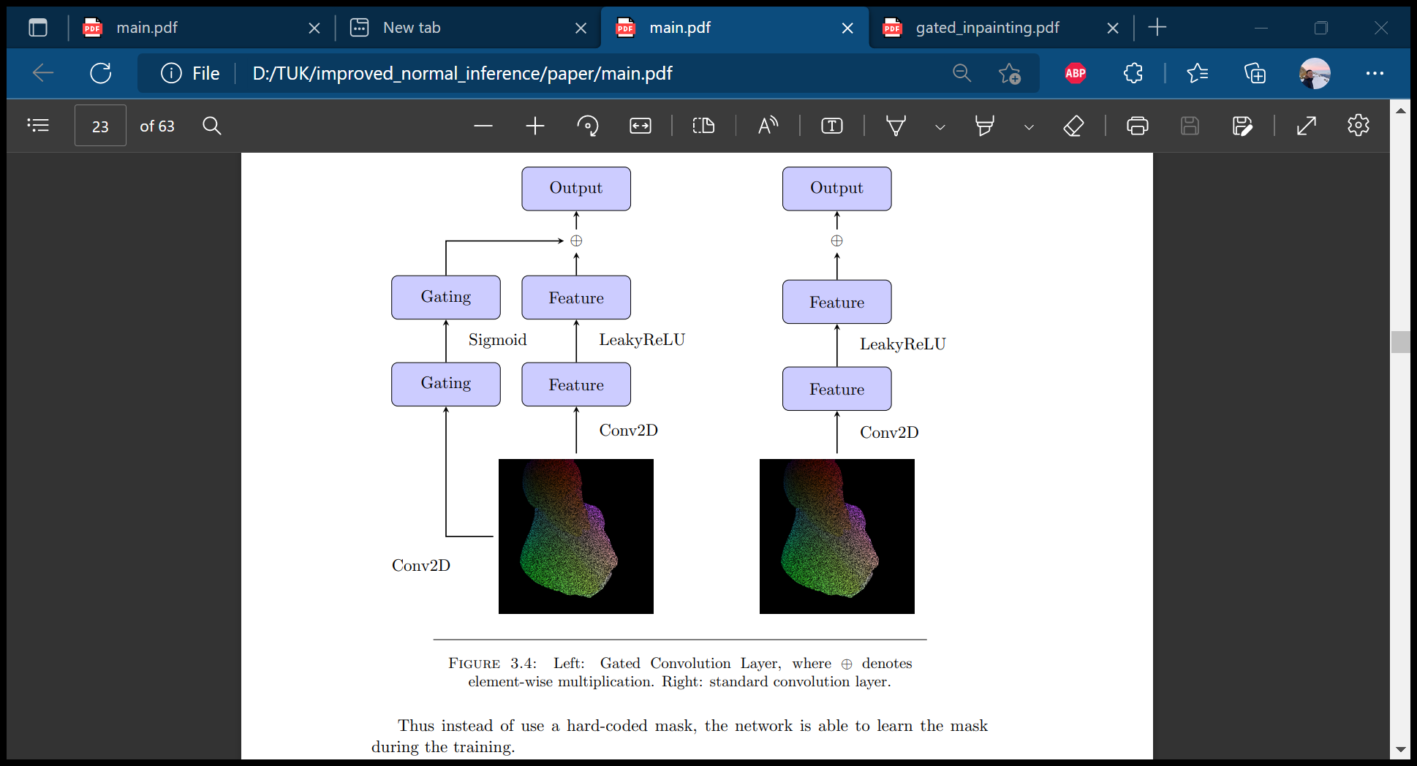
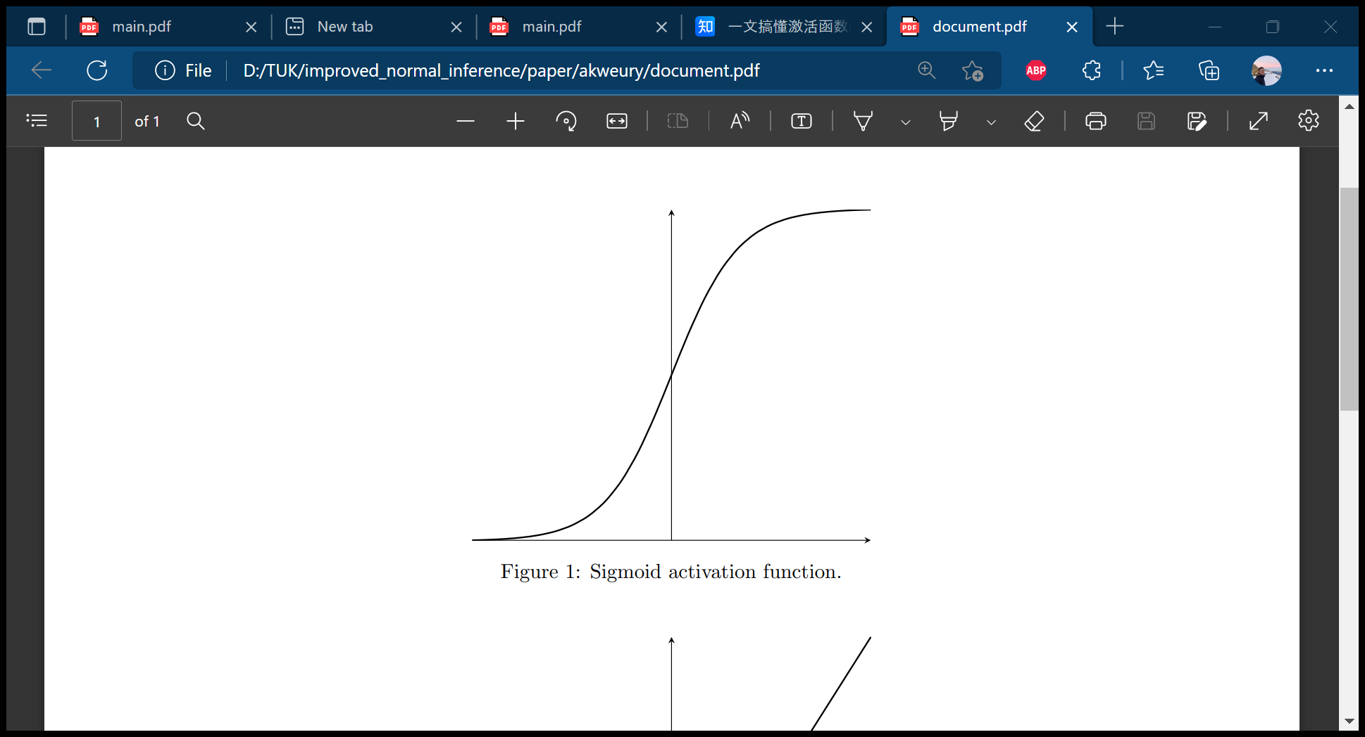
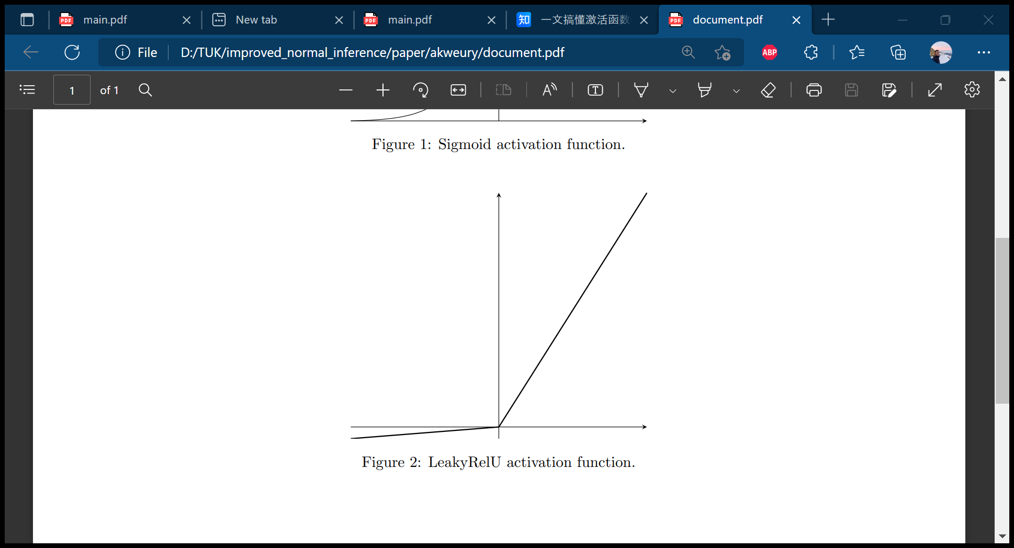
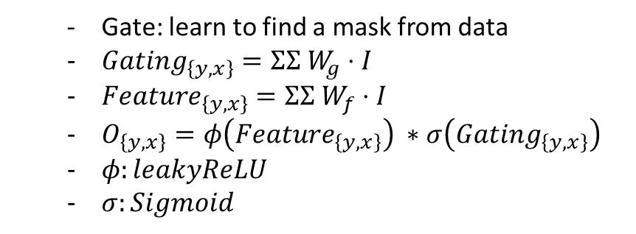
Gated Convolution Layer (gconv)
Gate: learn to find a mask from data
$Gating_{\left\{y,x\right\}}=ΣΣ W_{g}⋅I$
$Feature_{\left\{y,x\right\}}=ΣΣ{ W}_{f}⋅I$
$O_{\left\{y,x\right\}}=φ\left(Feature_{\left\{y,x\right\}}\right) ∗σ\left(Gating_{\left\{y,x\right\}}\right)$
$φ:leakyReLU$
$σ:Sigmoid$

Slide 6
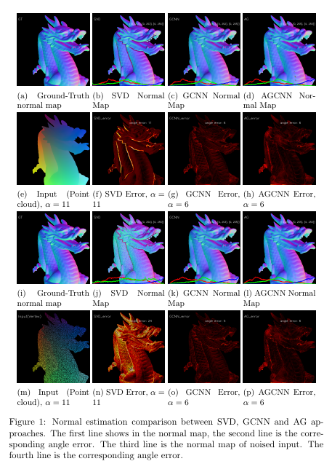
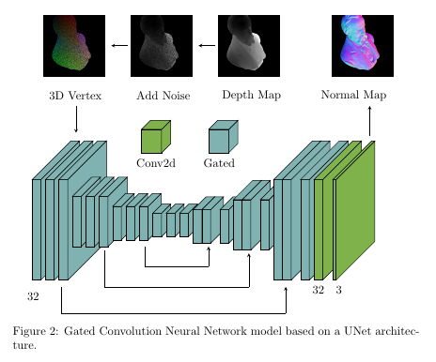
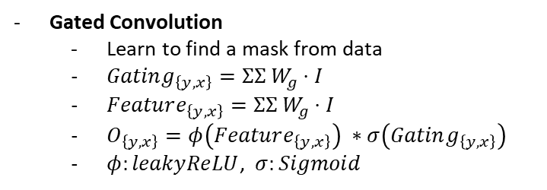
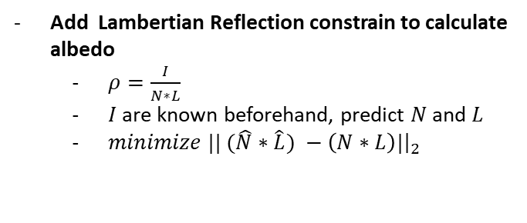
Gated Normal Neural Network (GNNN)
Gated Convolution
Learn to find a mask from data
$Gating_{\left\{y,x\right\}}=ΣΣ W_{g}⋅I$
$Feature_{\left\{y,x\right\}}=ΣΣ{ W}_{g}⋅I$
$O_{\left\{y,x\right\}}=φ\left(Feature_{\left\{y,x\right\}}\right) ∗σ\left(Gating_{\left\{y,x\right\}}\right)$
$φ:leakyReLU$, $σ:Sigmoid$
Add Lambertian Reflection constrain to calculate albedo
$ρ=\frac{I}{N∗L}$
$I$are known beforehand, predict $N$ and $L$
$minimize || (\hat{N}∗\hat{L}) −\left(N∗L\right)|{\left.​\right|}_{2}$
Down-sampling
Up-sampling
Notes:
Skip connections: Propagate detailed color or texture information to the decoder of that region

Slide 7
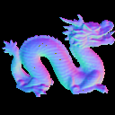
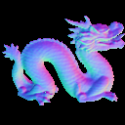
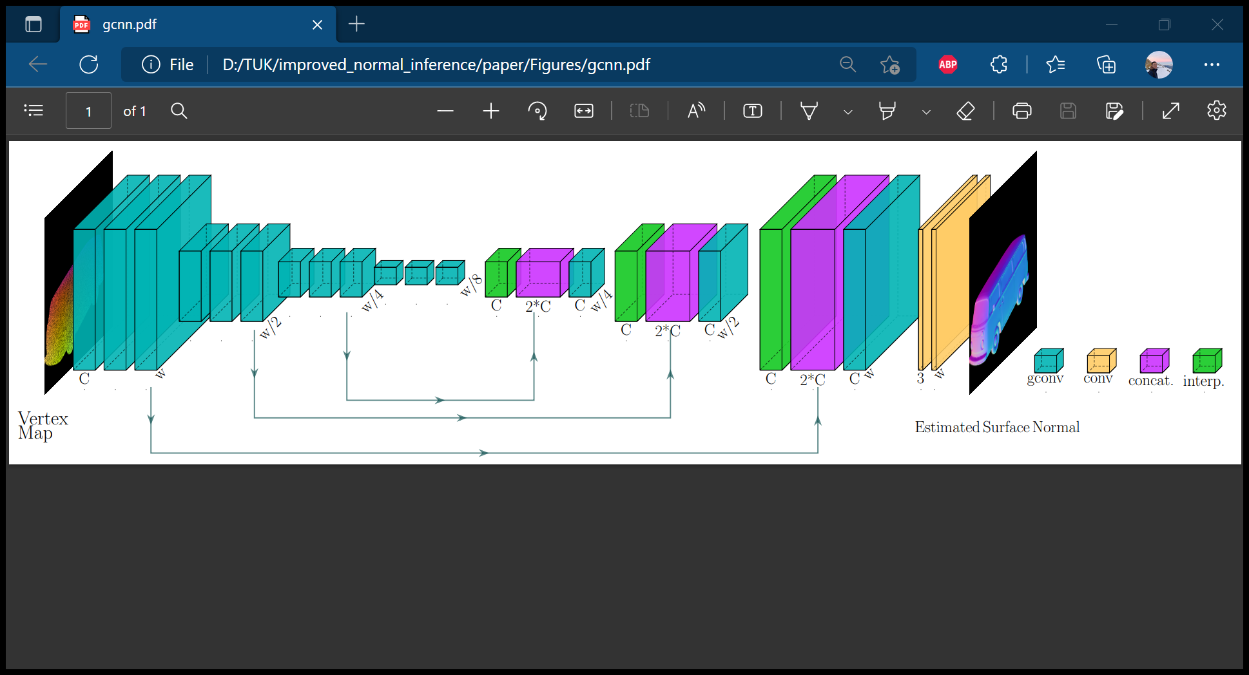
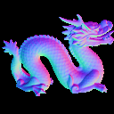
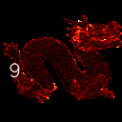
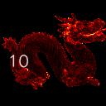
Gated Convolution Neural Network
No guide
Image guided
Ground-truth
Architecture:
3 gated conv Layers
3 times downsampling (gated conv layers) ,
3 times upsampling (gated conv layers) ,
2 conv2d layers (standard conv layers)
Loss:
Reversed Huber Loss
Down-sampling
Up-sampling

Slide 8
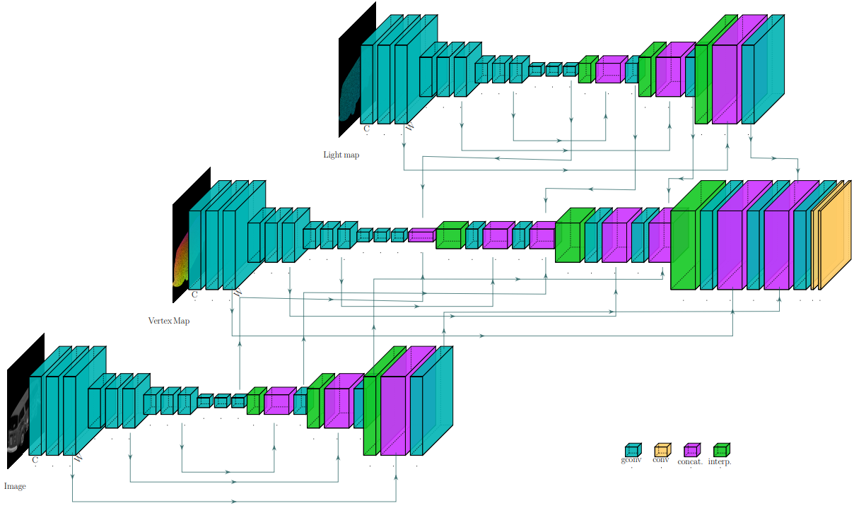
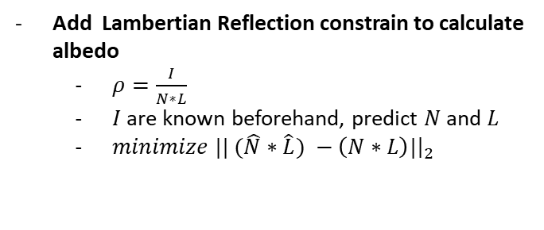
Trip-Net
Add Lambertian Reflection constrain to calculate albedo
$ρ=\frac{I}{N∗L}$
$I$are known beforehand, predict $N$ and $L$
$minimize || (\hat{N}∗\hat{L}) −\left(N∗L\right)|{\left.​\right|}_{2}$

Slide 9
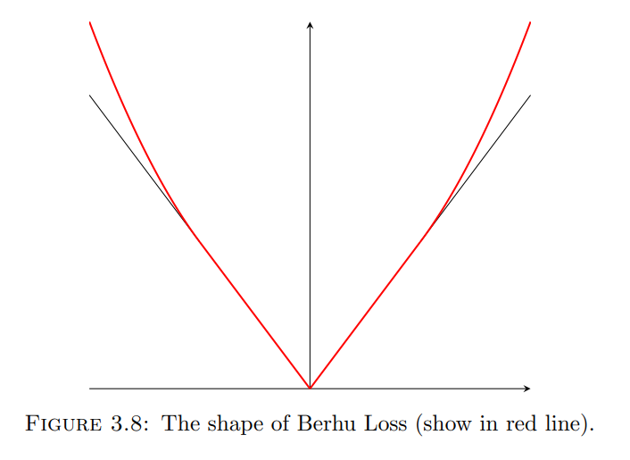
Loss function

Slide 10
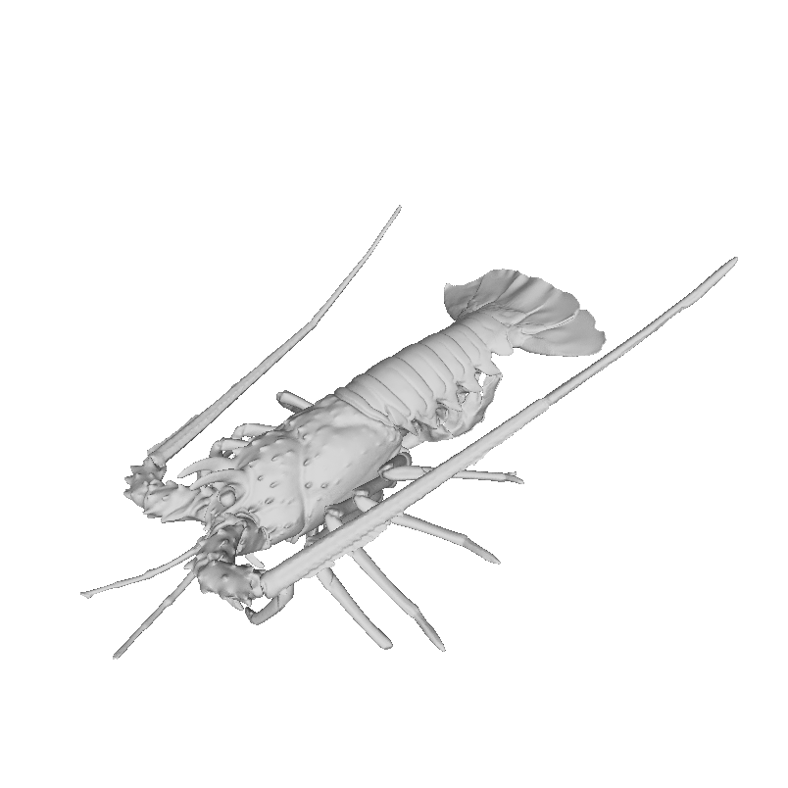
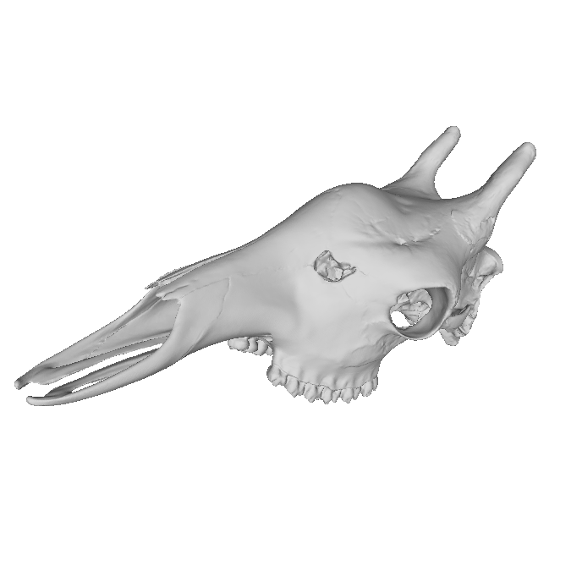
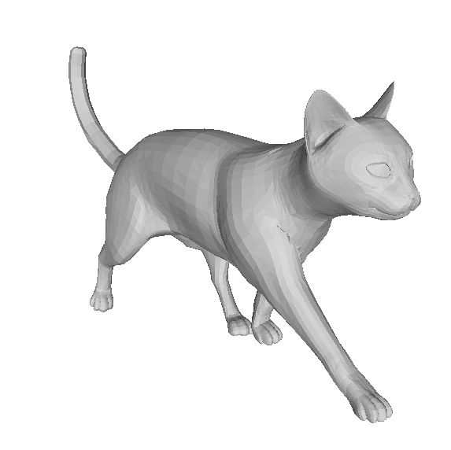
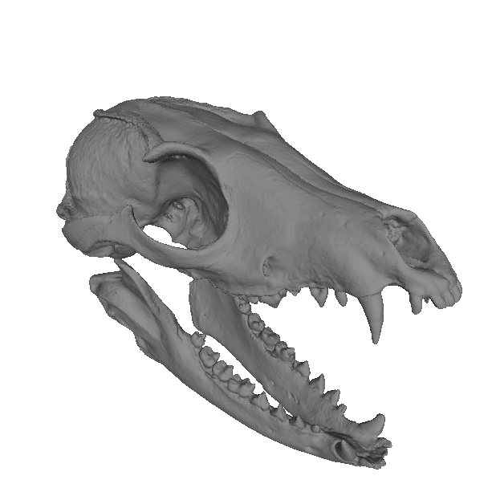
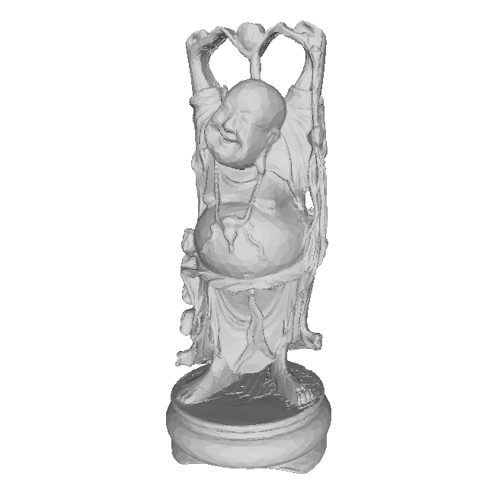
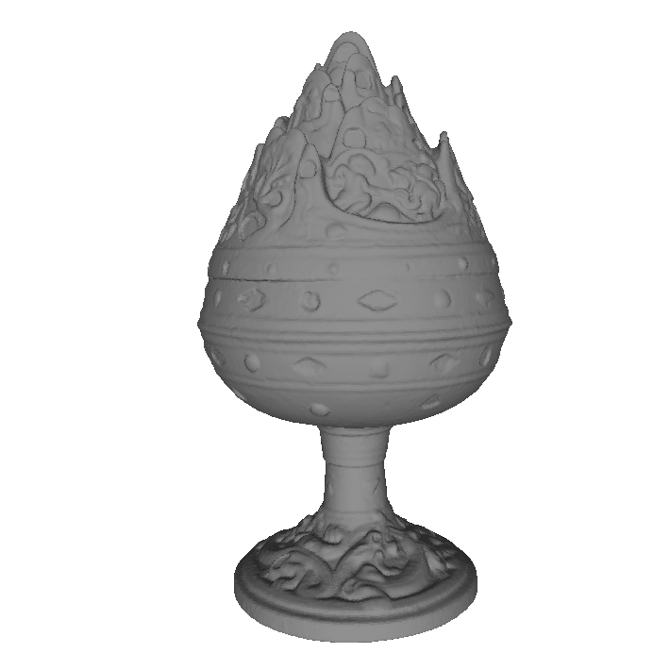
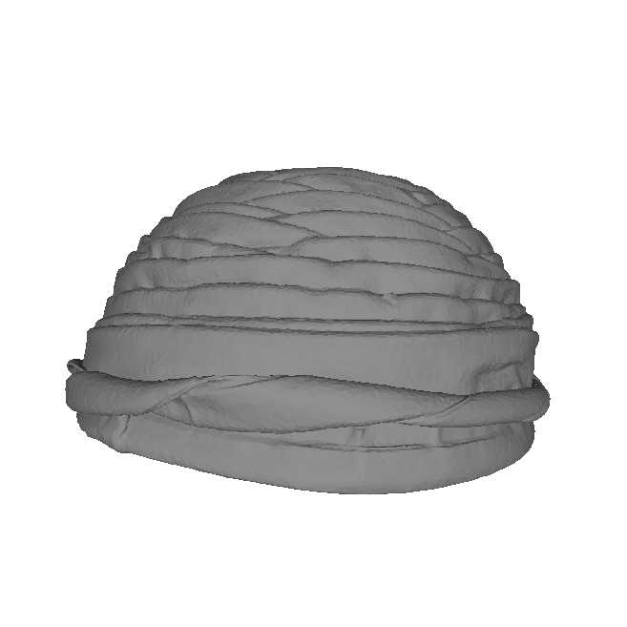
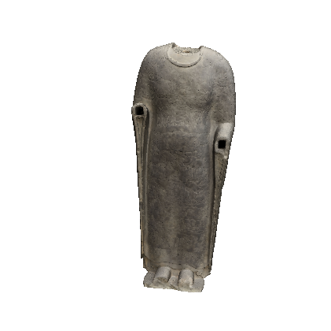
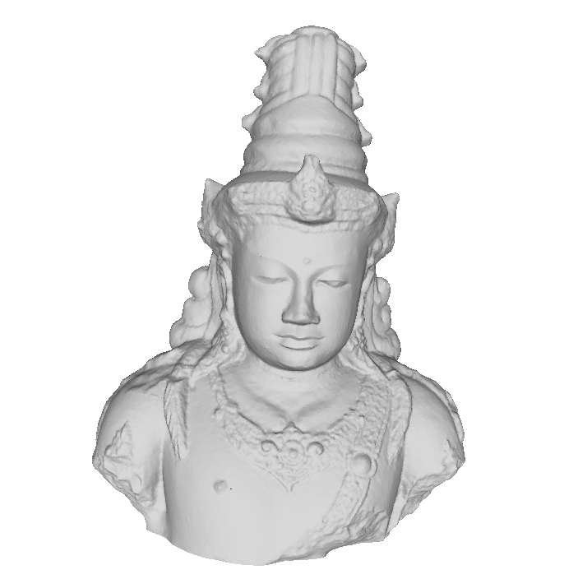
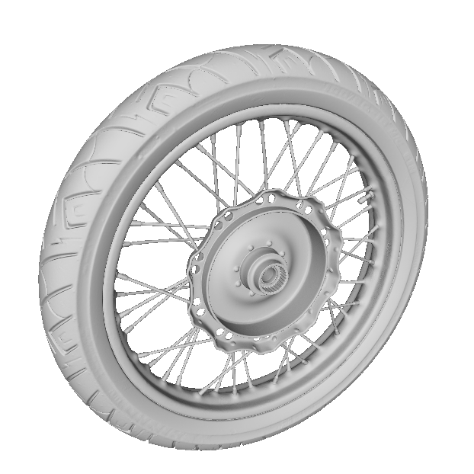
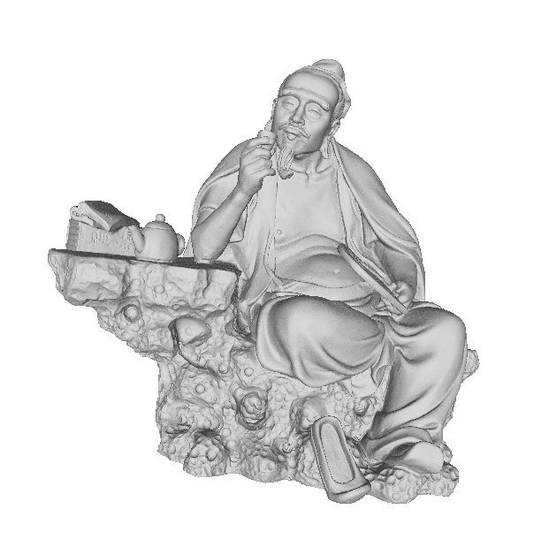
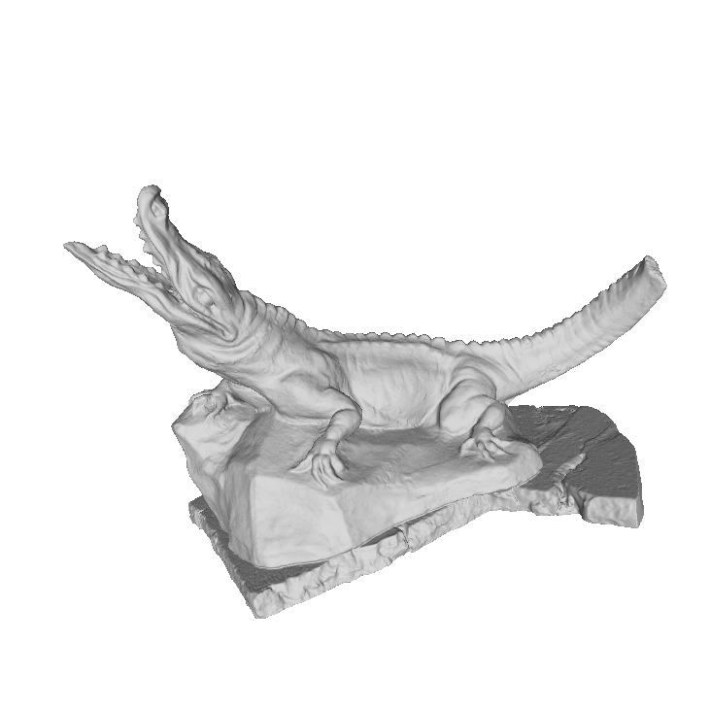
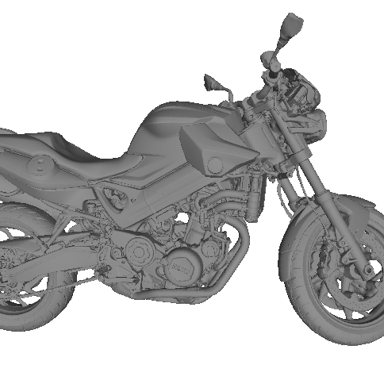
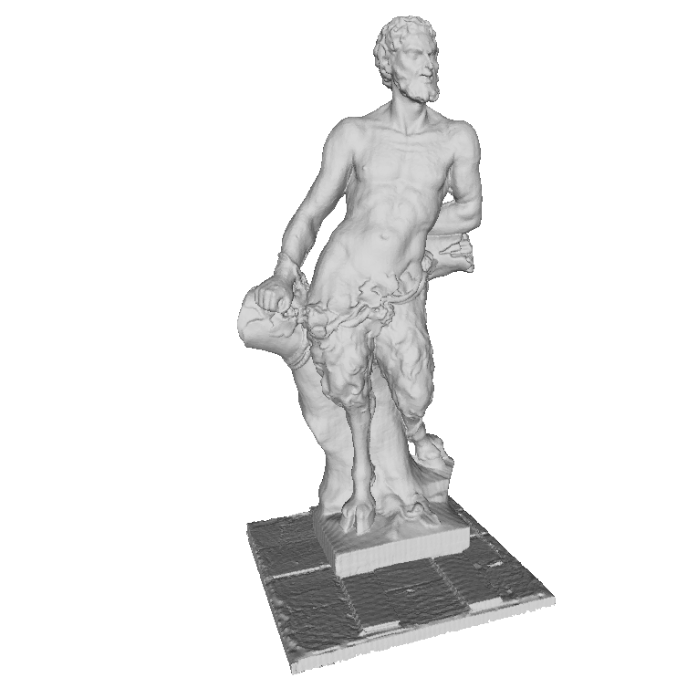
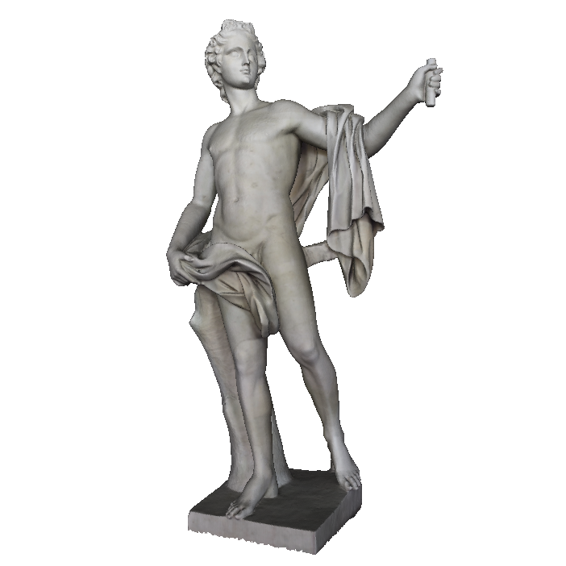
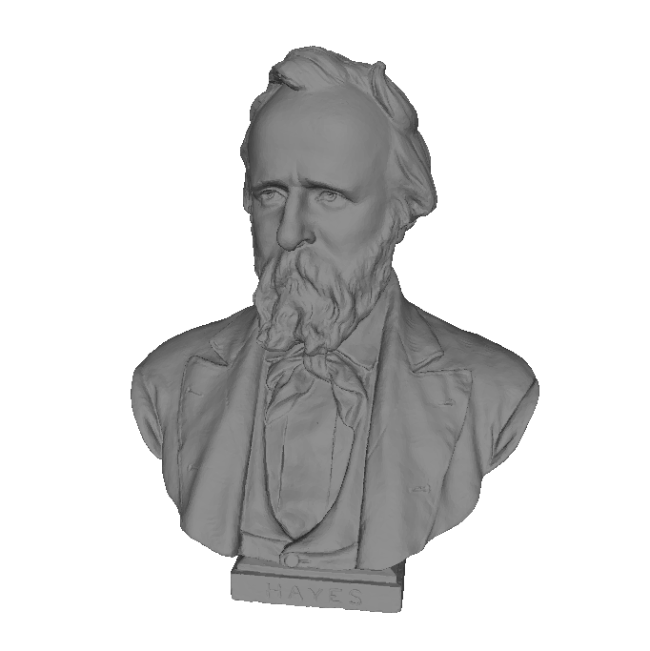
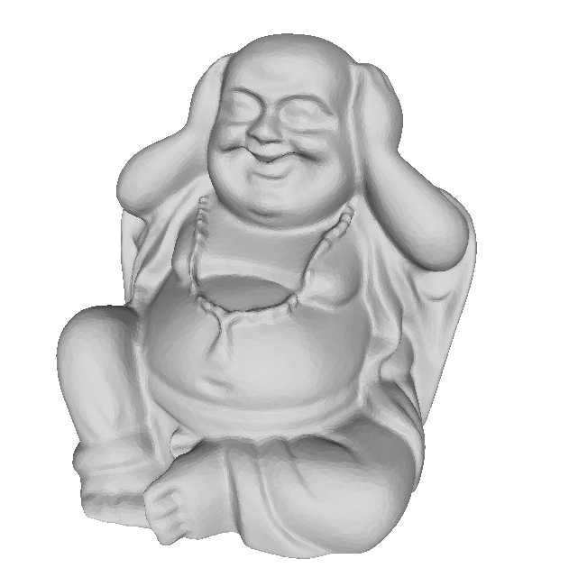
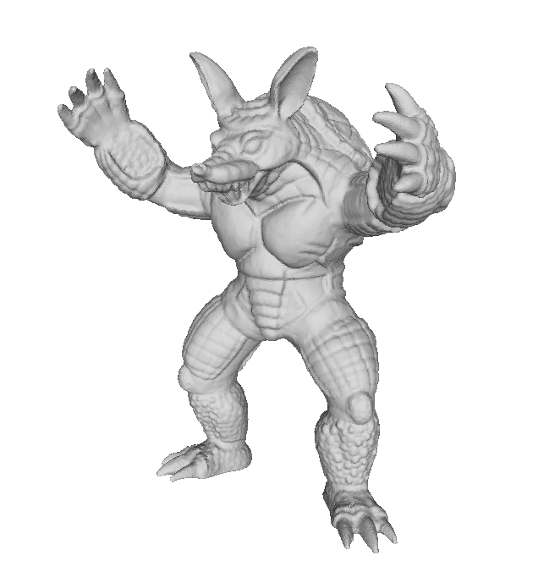
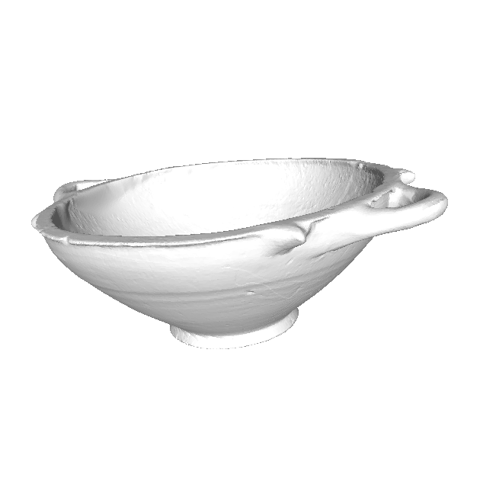
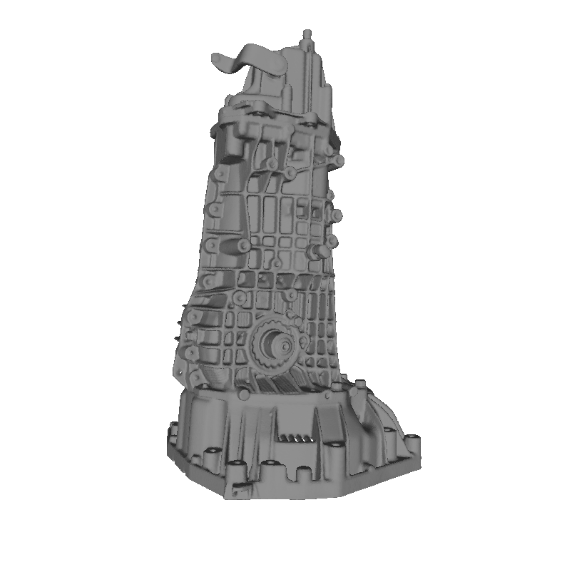
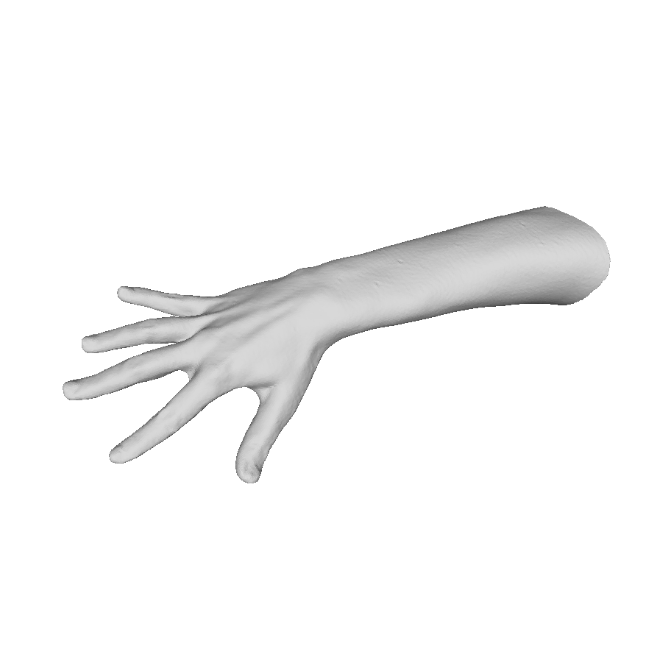
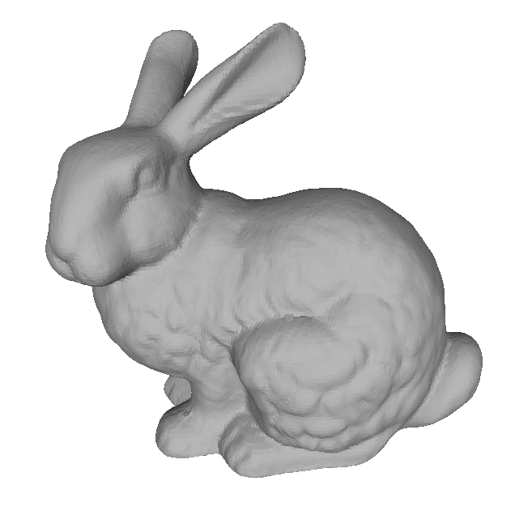
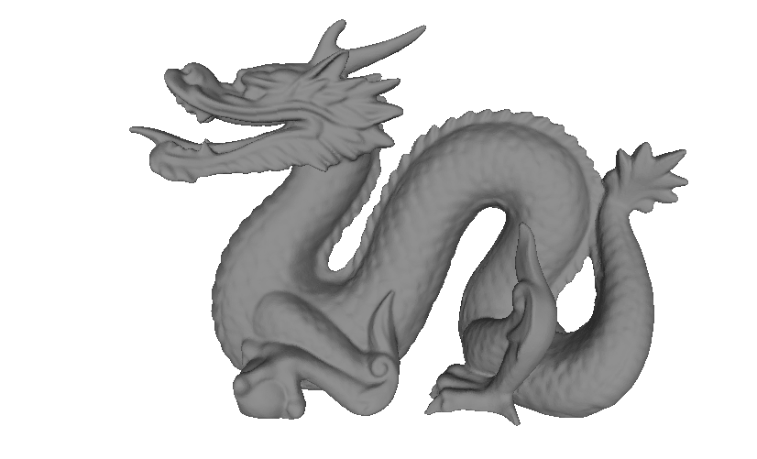
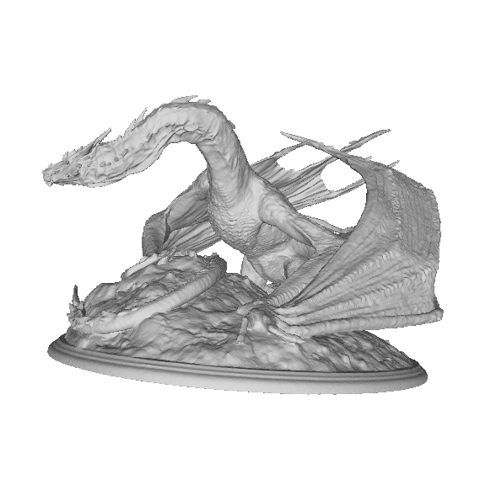
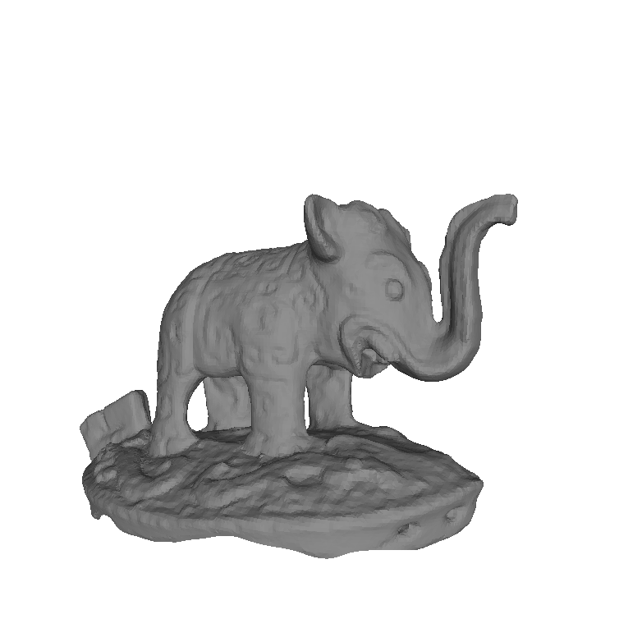
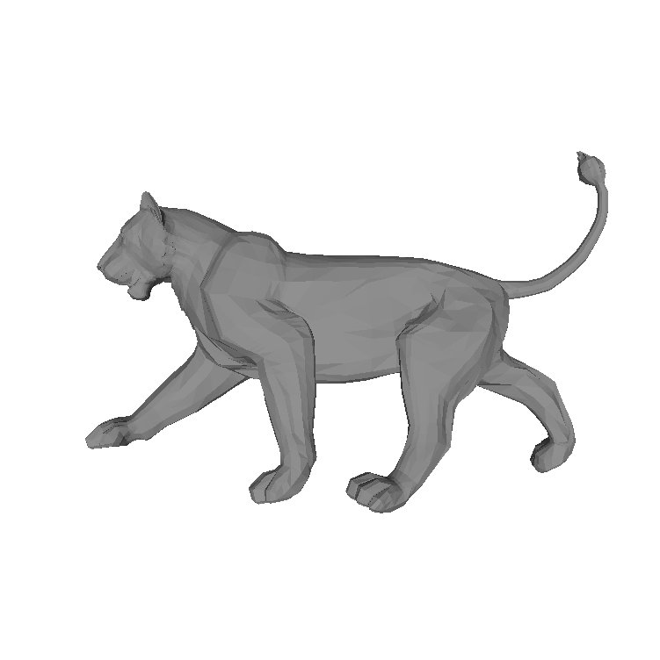
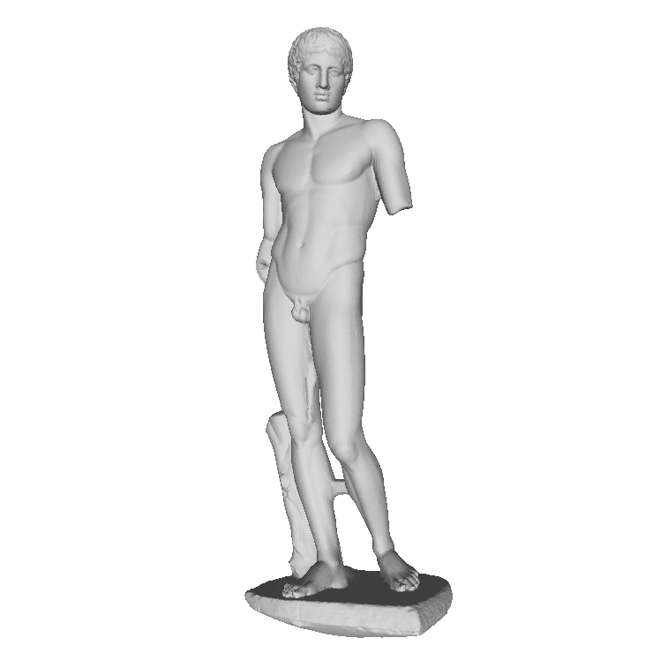
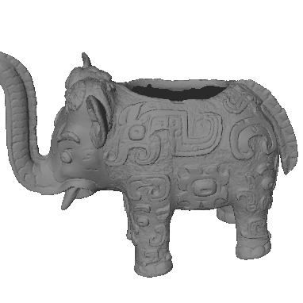
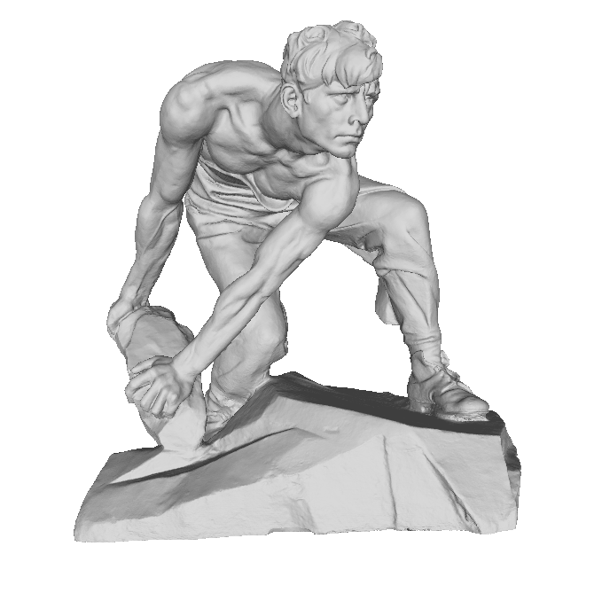


























Dataset
Training
50 point clouds
5 point clouds
Test

Slide 11


Camera Preview
Object
Light
Unity Scene
Depth Camera

Slide 12













Dataset
Image
Normal
Depth
Noised Depth
For the same model, we capture the scenes from a number of random directions
Random Light position
Random object position and orientation

Slide 13






Dataset
Synthetic Dataset
Real Dataset
Simulated from Unity
Image resolution: 128x128/ 512x512
50 training objects
5 test objects
3000 training scenes/5000 training scenes
100 test scenes
Captured on a light scanner
Image resolution: 512x512
4 training objects
1 test objects
320 training scenes
80 test scenes

Slide 14
Evaluation

Slide 15

128 CNN Feature Maps
Size: 32x32
value: 0
1

Slide 16

128 NOC Feature Maps
Size: 32x32
value: 0
1

Slide 17

128 GCNN Feature Maps
Size: 32x32
value: 0
1

Slide 18

Image guided model
I added an image branch as guided inference, and further use multiple times fusion for two subnetworks, but the result is worse then pure depth map based networks. The error of this evaluation image is 10, which GCNN usually achieves 9.
No guide
Image guided
Ground-truth

Slide 19
Training Work
Model | Size | Channel Num | Loss | Batch Size | Train on | Training Statue
GCNN-5 | 512 | 64 |  | 4 | 1000 | trained
GCNN-5 | 128 |  |  |  |  | pending
GCNN-3 | 512 | 64 |  | 4 | 1000 | Trained
GCNN-3 | 512 | 32 |  | 8 | 1000 | Trained
GCNN-3 | 64 | 128 |  | 64 | 6000 | Trained
Image Guided | 512 | 64 |  |  |  | pending
Light Guided | 512 | 32 | Albedo,light | 5 | 1000 | pending
Light guided | 512 | 32 | Albedo | 8 | 1000 | training

Slide 20
light direction guided model
For the illumination based method, I added following codes at the end of GCNN network to predict the albedo,
x_g = Gconv(torch.cat((x_normal_out, x_light), 1)) x_albedo = Gconv(torch.cat((x_g, x_img), 1))
and use ||(rho(N*L)-I)||_2^2 to calculate the image loss with a mask for valid pixels, since the light direction is calculated based on the semi-dense point clouds, therefore it is also very noisy.
I also added the l2 loss of the normal.
But it didn’t learn too much.

Slide 21







128x128
128x128
Input
Ground-truth
GCNN
SVD

Slide 22

128x128
128x128
Evaluation on 100 test items
Method | Angle Loss (avg)
SVD | 53.97
GCNN | 13.68

Slide 23








256x256
256x256
Input
Ground-truth
GCNN
SVD

Slide 24

256x256
256x256
Evaluation on 100 test items
Method | Angle Loss (avg)
SVD | 33.53
GCNN | 10.50

Slide 25



U-CNN
U-GCNN
U-NOC

Slide 26



U-CNN
U-GCNN
U-NOC

Slide 27







Image
Vertex
GT
SVD
CNN
NOC
GCNN

